Slide 1
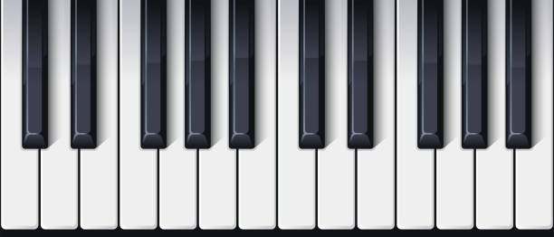
EC311: Electric Keyboard
Alex Hack
Michael Barany
James Conlon
Ethan Levine

Slide 2
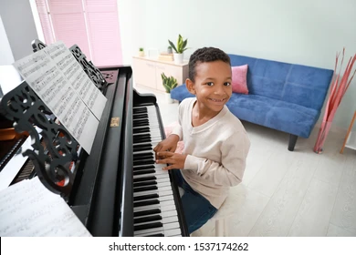
Goal/Motivation
Project Objective: Design and implement a digital system using Verilog HDL that responds to keyboard inputs to produce musical notes. This system will be capable of changing octaves and outputting sounds through a speaker.
Usage: This design could be used in a variety of ways such as: music education, basic music production, and accessibility for disabled musicians.
Notes:
Project Objective: Design and implement a digital system using Verilog HDL that responds to keyboard inputs to produce musical notes. This system will be capable of changing octaves and outputting sounds through a speaker.
Motivation: Prior to Lab 3, we had the idea to create a device functioning on keyboard interactions with an element of sound usage. Expanding upon that idea we decided to design a system which functions under similar principles but serves as a sound recognition device. In this system, keyboard inputs are used to play musical notes, while an FPGA module interprets these inputs, converting them into sound emitted through a speaker. This sound is then interpreted by the user who guesses the note, then via button input the 7 segment display will display the actual note sound. Another feature is playing music using system. Similarly different output waveforms may be played and thus different sound types may be emitted.
Usage: This design could be used in a variety of ways such as: music education, basic music production, and accessibility for disabled musicians.

Slide 3
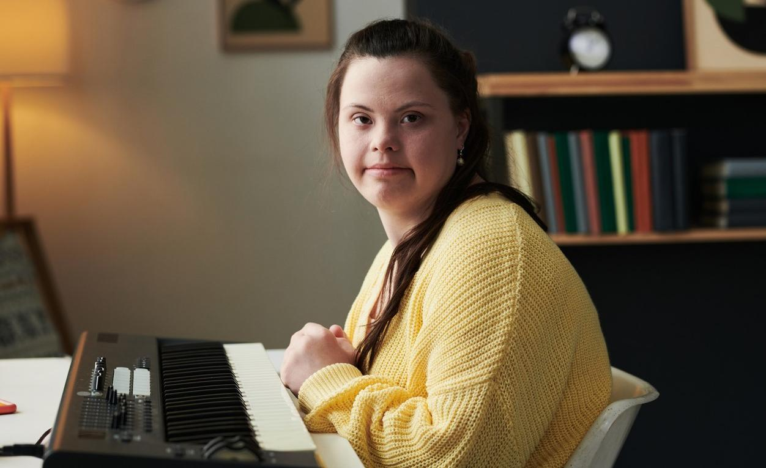
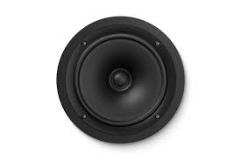
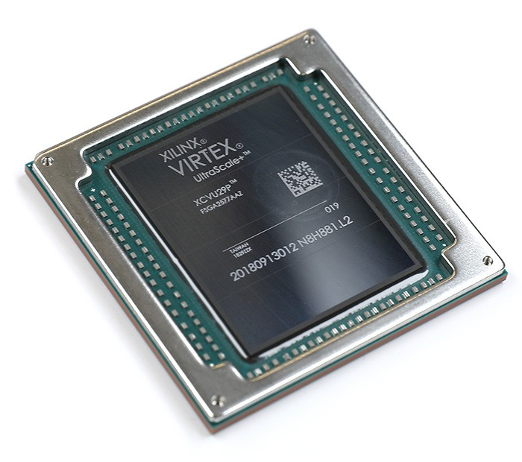
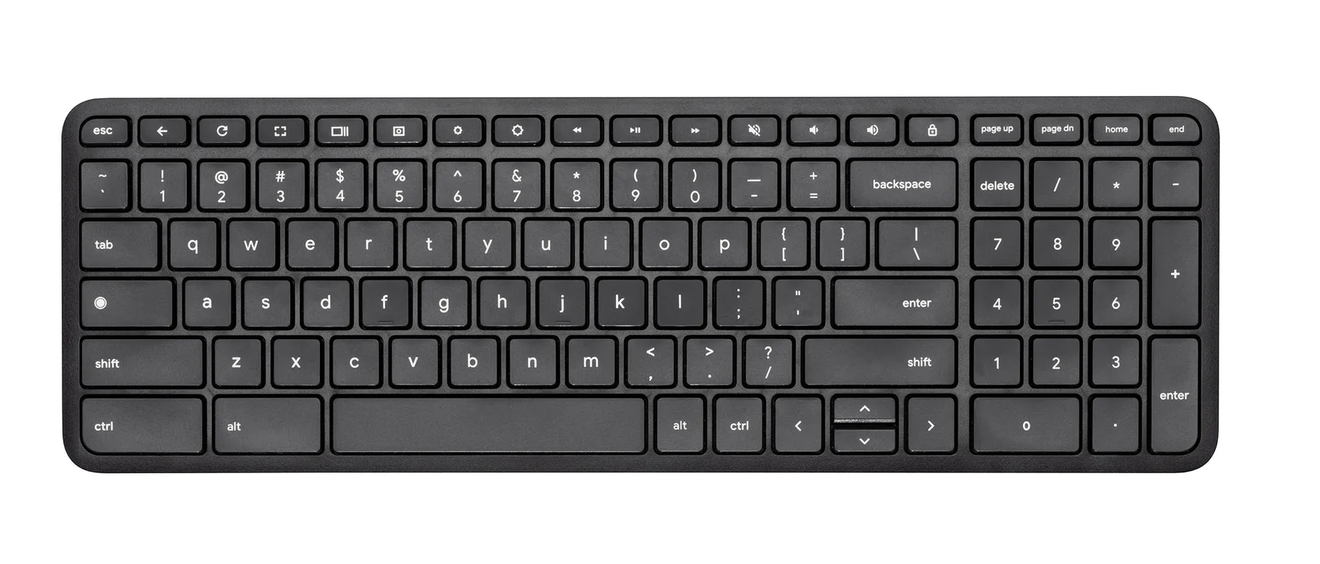
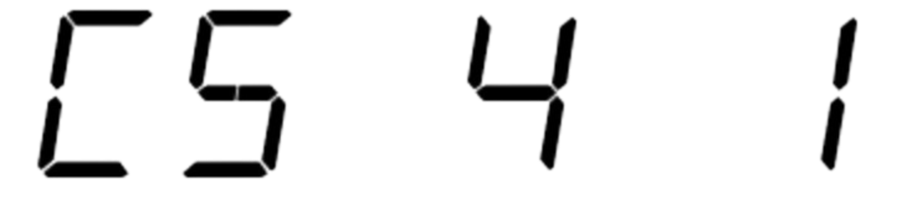
Short Functionality
Play Different Notes on Keypresses
Change octave using up and down arrow keys
Change instrument sound with number keys
Note played through speaker or headphones connected to audio jack
Display Note, Octave, and Waveform on 7 Seg Display

Slide 4


Short Specification
Output sounds
At desired frequency
And waveform
At least 12 unique notes
C,C#,D,D#E…
Different Octaves
At least 2 unique waveforms

Slide 5

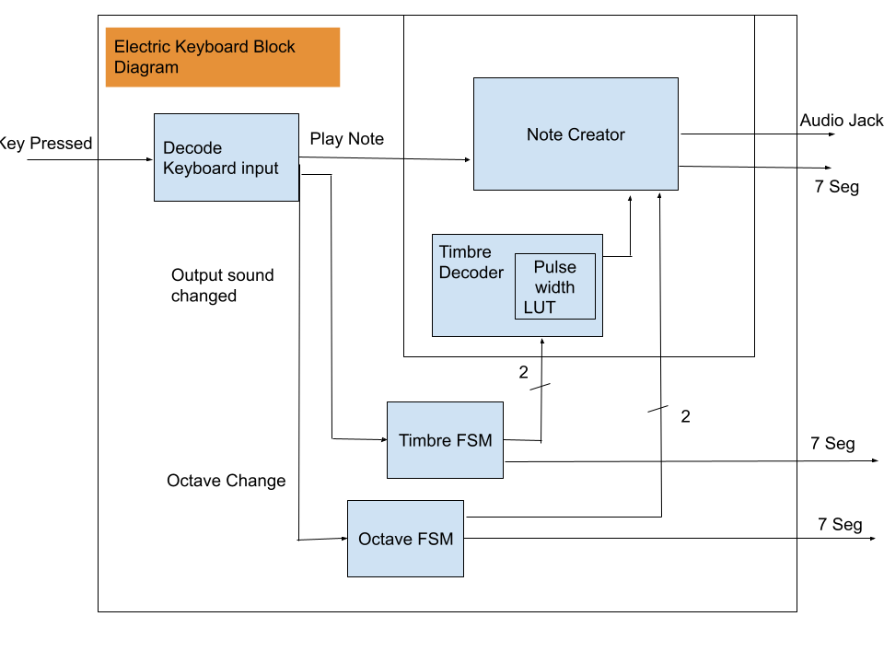
Detailed Block Diagrams

Slide 6
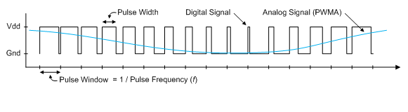
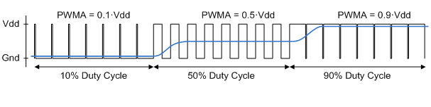
Theory: Creating Analog waves from Digital Pulse Width Modulation
SK Butterworth Low-Pass Filter connected to the audio jack
Varying the duty cycle creates different waveforms at different frequencies
Frequency determines the note, waveform determines the sound of the note

Slide 7
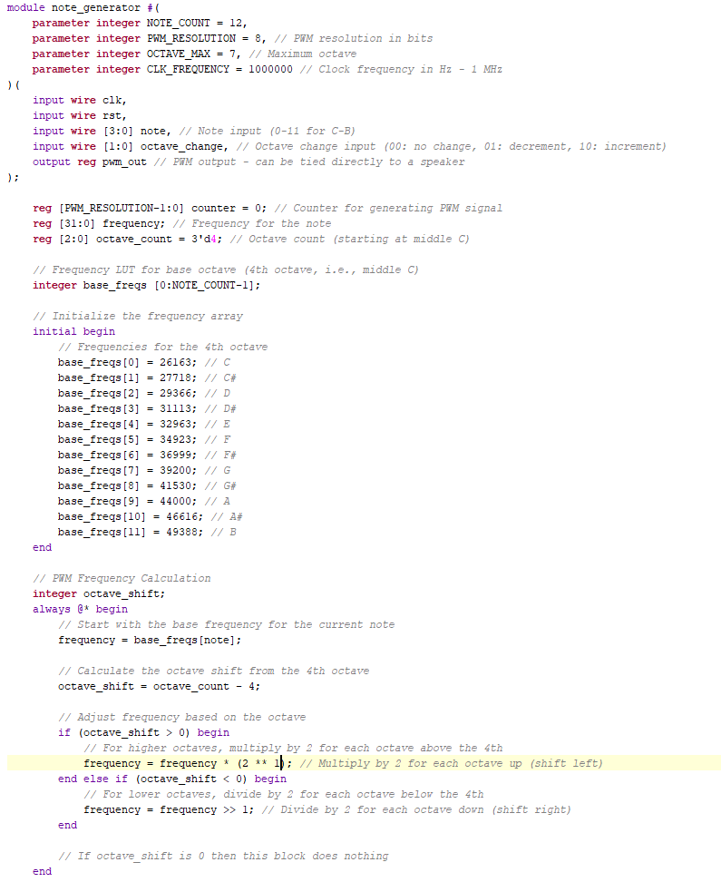
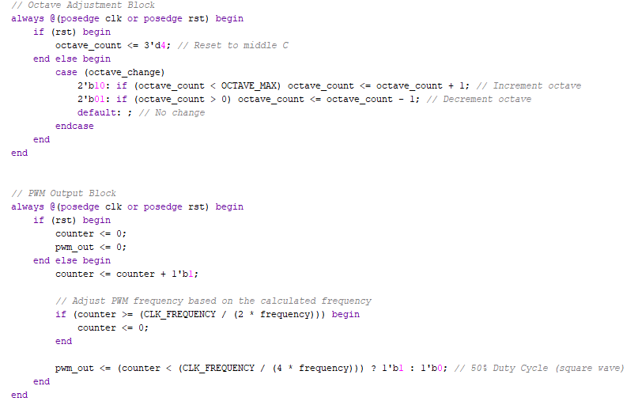
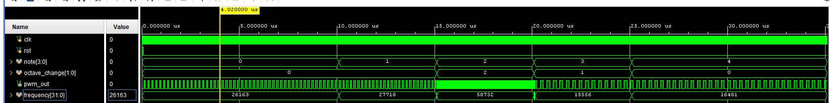
Code Snippet: Basic notes
C , C#, D (octave up), D# (octave down), E
2
Notes:
To get the frequency it is really easy to count rising edges and divide by the period. We could count all the rising edges and divde by the period to get the frequency, which i have done.
do that to confirm that the notes we selected in the tb match the output frequency.
It just uses a basic counter logic in the bottom block. Notice how it is 2* frequency in the bottom block because the signal has to be high for exactly half of the period and low for exactly half of the period. So we toggle pwm_out when the counter reaches half a period
For a variable duty cycle we will replace the 2 here with some variable duty cycle to get more interesting waves
(talk about octave calculation)

Slide 8
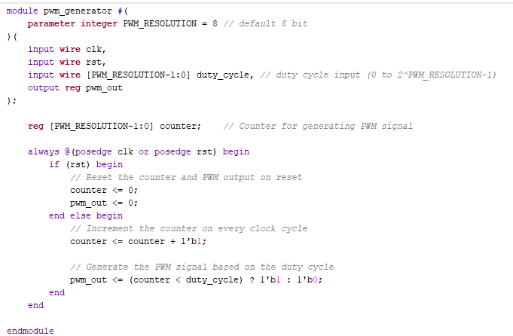
Code Snippet: Analog Wave creation with PWM
Notes:
the eventual goal is to connect the pwm_generator idea to the note_generator so we can modify the duty cycle for more sound dimension. The intent is to allow this second module to adjust the amplitude of the wave before being sent to the audio jack

Slide 9
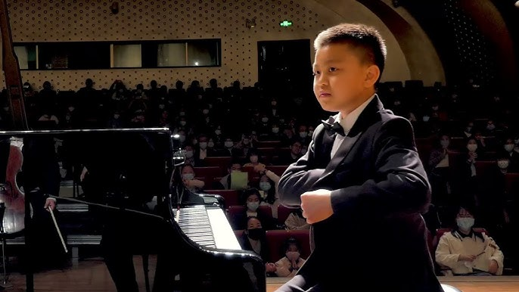
Successes
Keyboard inputs functions properly
Waveform correctly demonstrates analog wave behavior using PWM

Slide 10
Failures
The possibility of creating more complex waveforms for instruments such as pianos is quite difficult to replicate using a low pass filter output
Issues arose with the debouncer on the keyboard as inputs would create two outputs due to errors in its implementation
Generating correct output frequency from pwm datastream

